Slide 1
TELECOMMUNICATION CHURN PREDICTION
Anjali Raoji Chandane
Mrs. Chandrika K J
Nilakantha Panigrahi
Nirali BharatKumar Upadhyaya
Renu Rawat
Miss Swetha M V
Guide : Neha Gupta

Slide 2
Business Problem : Customer churn is a big problem for telecommunications companies. Indeed, their annual churn rates are usually higher than 10%. For that reason, they develop strategies to keep as many clients as possible. This is a classification project since the variable to be predicted is binary (churn or loyal customer). The goal here is to model churn probability, conditioned on the customer features.
Business Objective : The aim of this project is to build a feature where customer details will be provided and the model will predict whether the customer is going to churn or not.
Data Set Details: The data file telecommunications_churn.csv contains a total of 19 features for 3333 customers.
Each row corresponds to a client of a telecommunications company for whom it has been collected information about
the type of plan they have contracted, the minutes they have talked, or the charge they pay every month.

Slide 3
Exploratory Data Analysis

Slide 4
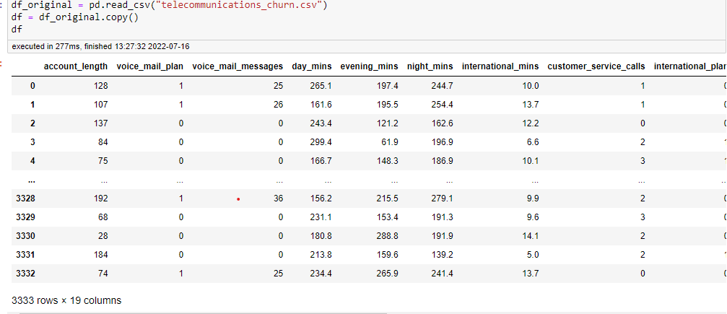
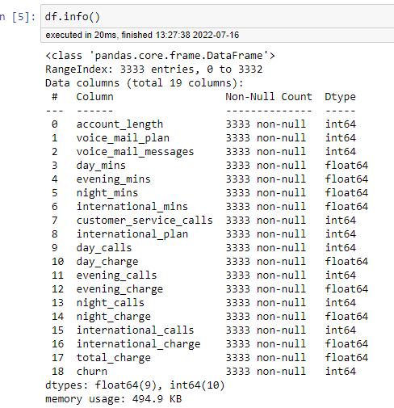
Dataset Details
3333 Records, 19 Features
All datatypes are in accordance with the values in the dataset
No null values are present
No duplicate rows present

Slide 5
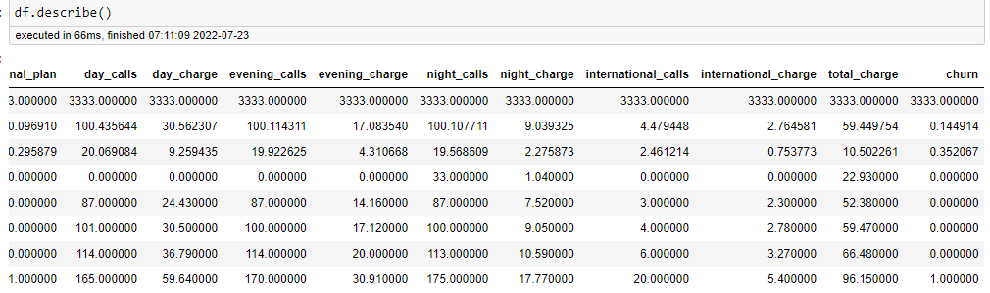
Average minutes a customer is talking on the phone during day, evening, night time is almost same.
Average number of calls made during day, evening, night time are almost same.
However, average Day charge is highest followed by evening and night charge
Day:evening:night charges are in the ratio 4:2:1

Slide 6
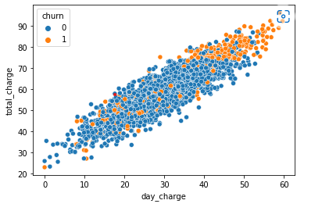
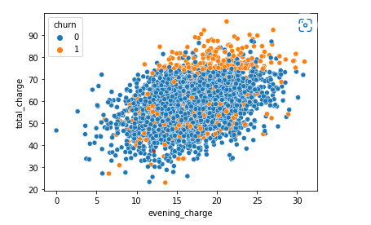
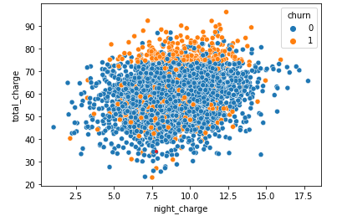
Day Charge has positive linear relationship with the Total charge ( correlation - 88% )
Evening charge has positive relationship with Total Charge ( correlation - 41% )
Night charge has less positive relationship with Total charge ( correlation - 21% )

Slide 7
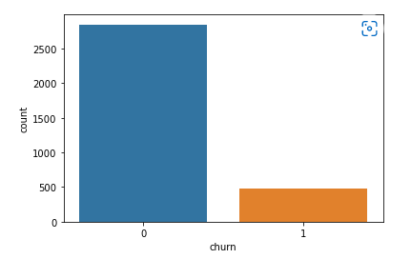
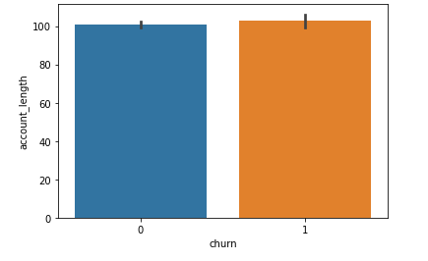
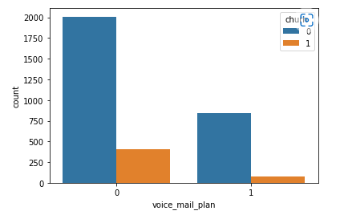
Account length has no effect on churning rate
Displays class imbalance ( Churn : Non-churn as 1:6 )
Churn minority class - 483 , Non-churn - 2850
Those who have no voice_mail_plan are high churners

Slide 8
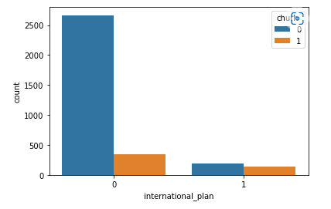
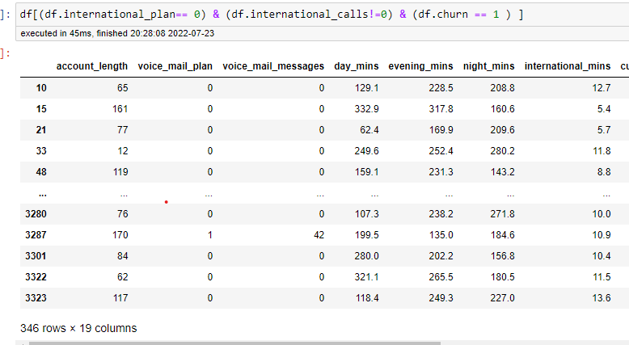
Those who have no international plan are high churners
Out of 483 churn customers 346 have no international_plan but have international_calls

Slide 9
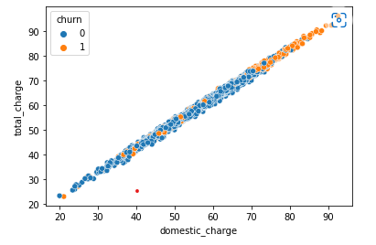
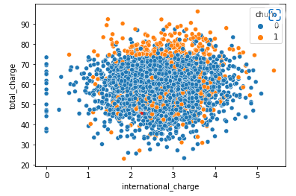
Total charge = Day charge + evening charge + Night charge + International charge
Total charge = Domestic charge + International charge
International charge is not linearly related to total charge
i.e. international charge is not contributing much to total charge
Domestic charge has positive linear relationship with the total charge
Customers having high domestic charge are mostly churning
Only few customers with less total charges have churned

Slide 10
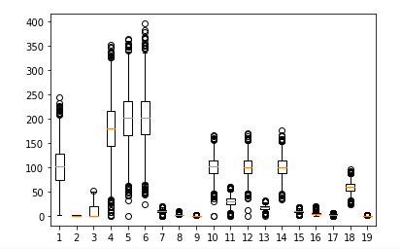
Outliers
Plotted outliers using boxplot & z-scores
Checked outliers for each feature
Not deleted any outliers as it was not confirmed whether they were data entry or measurement errors
Also deleting or changing outliers to their 10th or 90th percentile may lead to loss of information so, decided to not change the outliers

Slide 11
Feature Engineering
Feature Importance
Feature Scaling

Slide 12
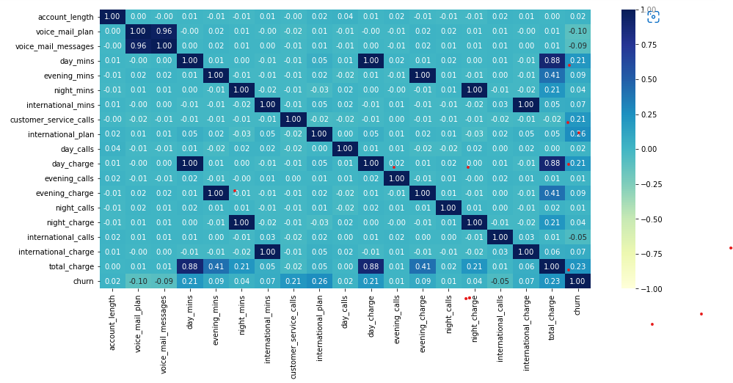
Correlation Matrix
Important Features
International plan
Total Charge
Day charge
Day Mins
Customer service calls
Highly correlated
voice_mail_plan & voice_mail_messages
day_charge & day_mins
evening_charge & evening_mins
night_charge & night_mins
total_charge & day_charge

Slide 13
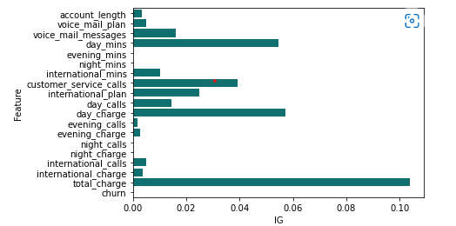
Mutual Information Gain
Important Features
1. Total Charge
2. Day Charge
3. Day Mins
4. Customer Service Call
5. International Plan

Slide 14
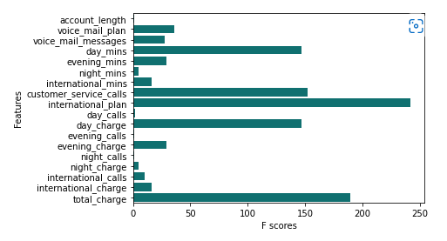
Anova Test
Important Features
1. International Plan
2. Total Charge
3. Customer Service Calls
4. Day Mins
5. Day Charge

Slide 15
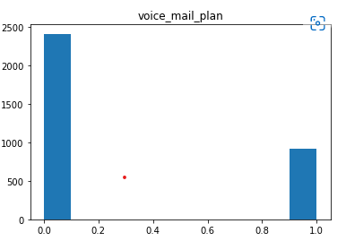
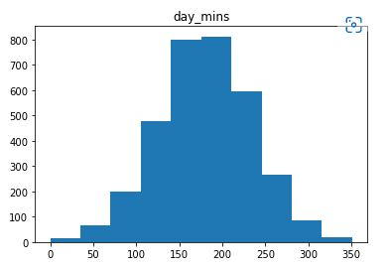
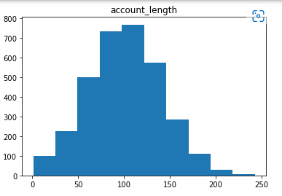
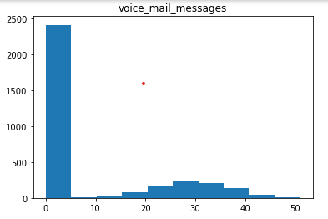
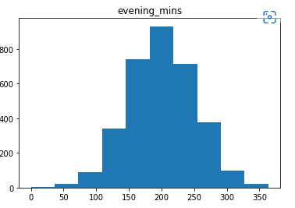
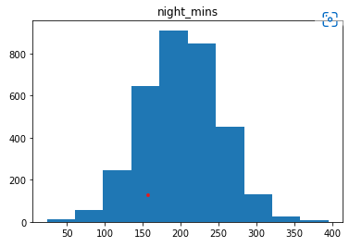
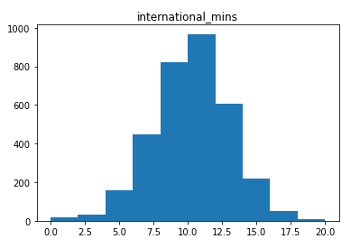
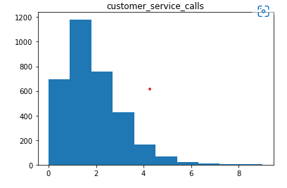
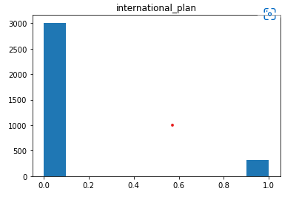
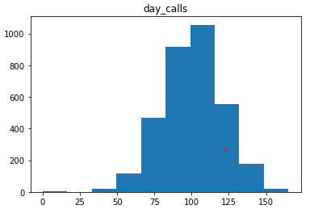
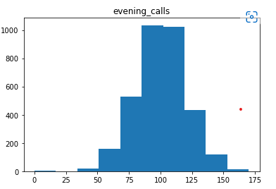
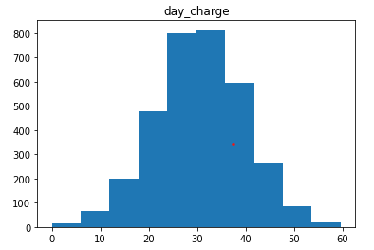
Transformations

Slide 16
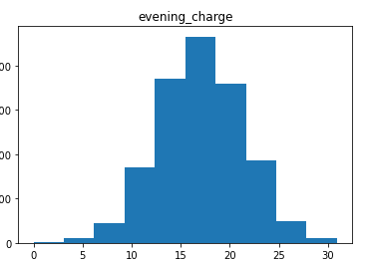
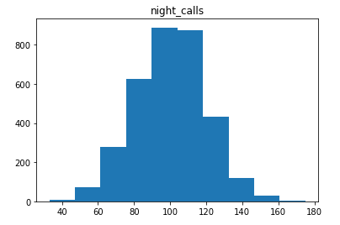
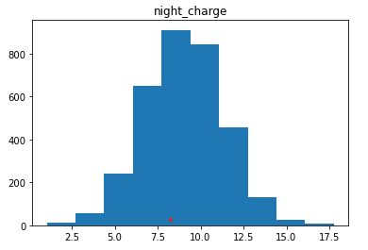
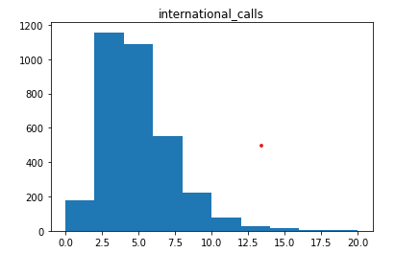
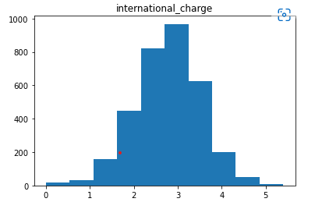
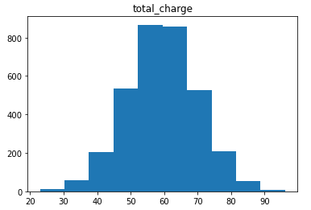
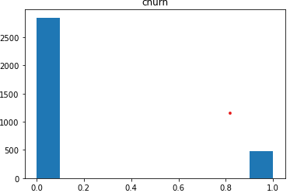
Histograms for international_plan, voice_mail_plan are bimodal.
Histograms for international_calls, customer_service_calls, voice_mail_messages are skewed with skewness > 1
Transformations were not done for these as they have discrete data
Data for remaining features is normally distributed.

Slide 17

Model Building and Training
Logistic Regression
Naive Bayes
Decision Tree
Random Forest
XGBoost

Slide 18
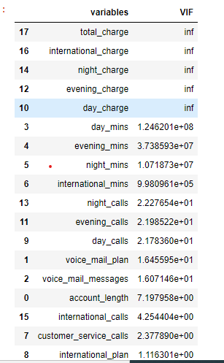
Multicollinearity
Total charge is an important feature , so it was not deleted
Deleted international charge, night charge, evening charge, day charge
as sum of these results in total charge
Again plotted VIF
Deleted Day mins as it has 88% correlation with total charge
Again plotted VIF
After deletion Dataset details are
3333 records, 13 features

Slide 19
Model Details
Logistic Regression
Gaussian Naive Bayes
Decision Tree
Random Forest Classifier
Extreme Gradient Boosting

Slide 20
Scaling Improves overall performance of all models
 | Accuracy Train | Accuracy Test | Precision_churn Test | Recall_churn Test | F1-score_churn Test
LR
Scaling | 0.86 | 0.87 | 0.57 | 0.31 | 0.40
w/o Scaling | 0.86 | 0.85 | 0.43 | 0.10 | 0.17
GNB
Scaling | 0.85 | 0.86 | 0.52 | 0.56 | 0.54
w/o Scalng | 0.86 | 0.85 | 0.46 | 0.37 | 0.41
DT
Scaling | 1.00 | 0.93 | 0.73 | 0.86 | 0.79
w/o Scaling | 1.00 | 0.95 | 0.82 | 0.87 | 0.84
RF
Scaling | 0.88 | 0.87 | 1.00 | 0.12 | 0.22
w/o Scaling | 0.87 | 0.87 | 1.00 | 0.08 | 0.15
XGBoost
Scaling | 1.0 | 0.98 | 1.00 | 0.85 | 0.92
w/o Scaling | 1.0 | 0.97 | 1.00 | 0.82 | 0.90

Slide 21
F1-score was highest with Hyperparameter tuning using GridSearchCV
 | Accu - GS ( Train ) | Accu - SM ( Train) | Accu - GS ( Test ) | Accu - SM ( Test ) | F1 - GS ( Test ) | F1 - SM ( Test )
LR
Scaled | 0.86 | 0.81 | 0.87 | 0.84 | 0.41 | 0.42
NB
Scaled | 0.85 | 0.82 | 0.85 | 0.85 | 0.49 | 0.52
DT
Scaled | 0.98 | 1.00 | 0.98 | 0.95 | 0.93 | 0.85
RF
Scaling | 0.98 | 0.96 | 0.99 | 0.97 | 0.95 | 0.88
XGBoost
Scaling | 0.98 | 1.00 | 0.99 | 0.99 | 0.95 | 0.95

Slide 22
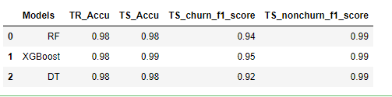
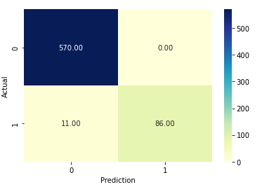
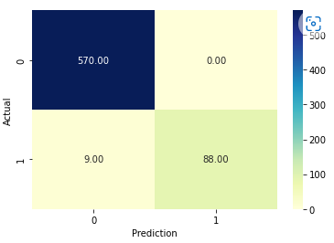
Comparing Random Forest & XGBoost Models
Random Forest
XGBoost

Slide 23
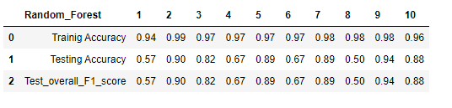
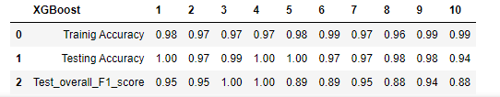
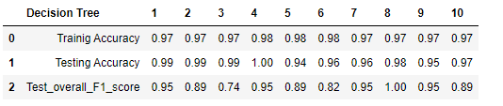

Slide 24
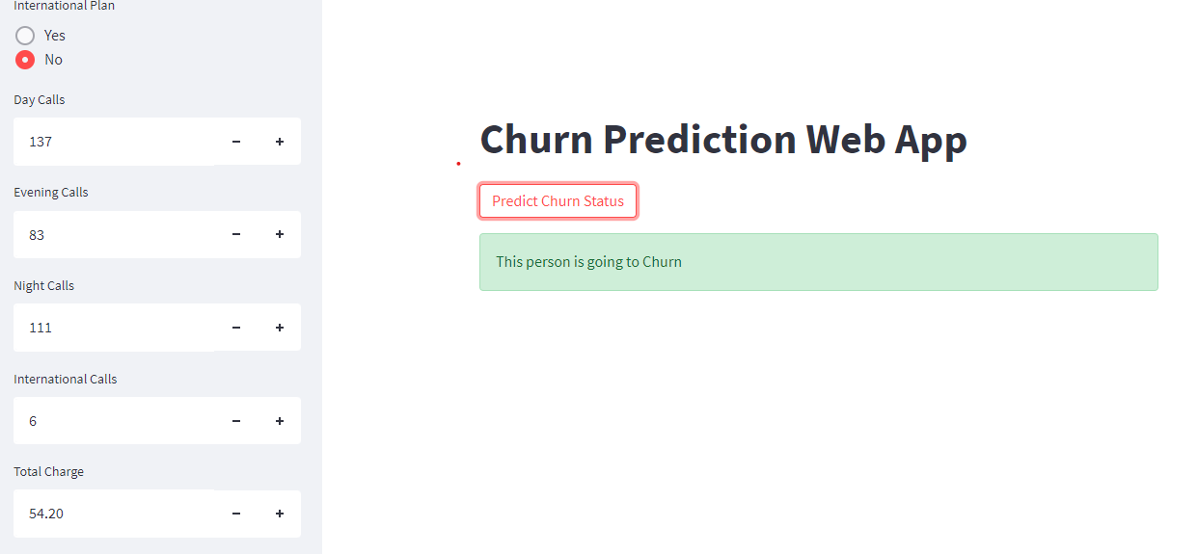
Deployment - Xgboost Classifier

Slide 25
Thank You

